Slide 1
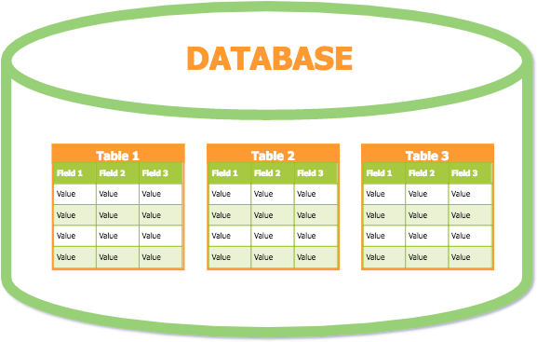
PUSL2019
Lesson 3
Entity Relationship Diagrams
1

Slide 2
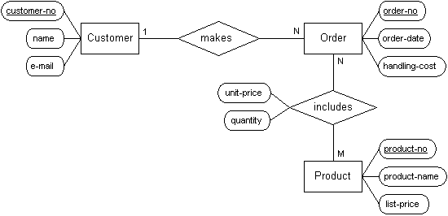
Entity Relationship Diagrams
Uses the concept of entities, relationships and attributes.

Slide 3
Entity
A group of objects with the same properties, which are identiﬁed by the enterprise as having an independent existence.
May be an object with,
physical existence (eg: person, car, house)
conceptual existence (eg: job, course, payment)
Employee

Slide 4
Attributes
Each entity has attributes.
Properties that describe it.
Name
Address
EmpID
Employee
TeleNo

Slide 5
Attribute Value (Attribute Domain)
The set of allowable values for one or more attributes.
A particular entity will have a value for each of its attributes.
The attribute values that describe each entity become a major part of the data stored in the database.
EmpID | Name | Address | TeleNo
E001 | Nimal Silva | 142, School Lane, Colombo 7 | 0777885522

Slide 6
Types of Attributes
Several types of attributes occur in the ER model:
Simple attribute
Composite attribute
Single valued attribute
Multi valued attribute
Stored attribute
Derived attribute

Slide 7
Simple (Atomic) Attributes
Attributes that are not divisible into smaller components.
More basic attributes with independent meanings
Eg:
EmpID – E001
Age - 30
Salary - 25000 FirstName – Nimal

Slide 8
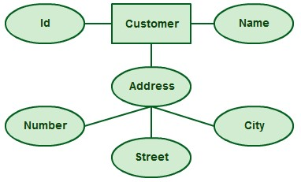
Composite Attributes
Attributes can be divided into smaller subparts.
The value of a composite attribute is the concatenation of the values of its component simple attributes.
House Number Street Name City
Address

Slide 9
Single Valued Attributes
An attribute that has a single value for a particular entity.
Eg:
Age – 30
DOB – 24/09/1984 EmpID – E001
FirstName – Nimal

Slide 10

Multi Valued Attributes
An attribute that has more than one value for a particular entity.
Eg:
TeleNo – 0115446000, 0777885522
Qualification – BSc(CS), MSc (IT), Dip(Eng)

Slide 11
Stored Attributes
An attribute whose value is fixed and cannot change.
Eg:
DOB - 24/09/1984 NIC – 845124578V

Slide 12
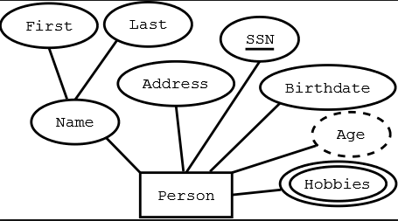
Derived Attributes
An attribute whose value can be derived from another attribute.
Eg:
Age – 30 (derived from DOB or NIC)

Slide 13
Some attribute values can be derived from related entities.
– An attribute Number_of_employees of a DEPARTMENT entity can be derived by counting the number of employees working in that department

Slide 14
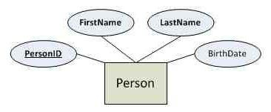
Key Attributes
An attribute who has unique values which helps to identify each and every entity uniquely.
It is underlined.

Slide 15

Entity Type
A set of entities that have the same attributes.
Strong Entity
Exists independently of other types of entities.
Has its own key attribute.
Weak Entity
Dependant on a strong entity.
Cannot exist on its own.
Does not have its own key attribute.

Slide 16
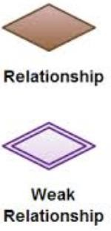
Relationships
An association (connection) between two or more entities.
An entity cannot exist isolation.
They always exist in relationships.
Identifying Relationship
– A relationship which associate with a weak entity.

Slide 17
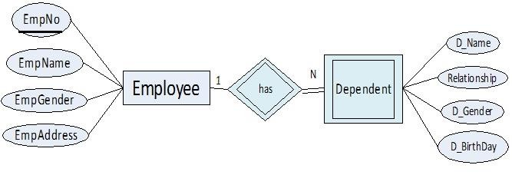
Weak Entity and Relationship Example

Slide 18
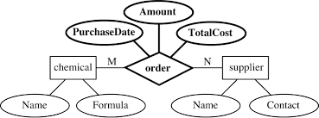
Relationship Attributes
Attributes in the relationship
Relationship attributes may appear when two or more entities link together via a particular relationship.

Slide 19
Degree of a Relationship
The number of participating entity types in a relationship.
Unary Relationships
Binary Relationships
Ternary Relationships

Slide 20
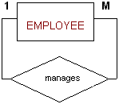
Unary Relationship
Also called as ‘Recursive Relationships’.
An entity has a relationship to itself.
A relationship type where the same entity type participates more relationship than once in different roles.

Slide 21
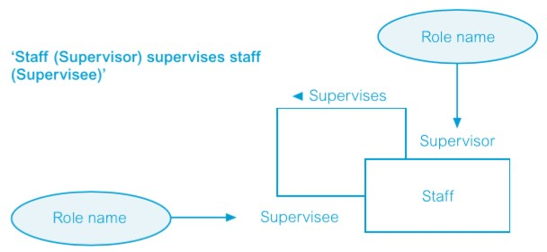
Unary Relationship
A loop is used to show that an occurrence of an entity may be associated with other occurrences of the same entity.

Slide 22
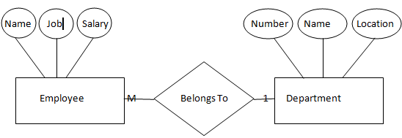
Binary Relationship
Two entities are connected in one relationship.

Slide 23
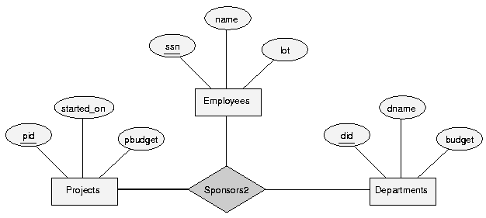
Ternary Relationship
Three entities are connected to a particular relationship.

Slide 24
Multiplicity (Cardinality Ratio)
The number (or range) of possible occurrences of an entity type that may relate to a single occurrence of an associated entity type through a particular relationship.
one-to-one (1:1)
one-to-many (1:M)
many-to-many (M:N)

Slide 25
Participation Constraint
Determines whether all or only some entity occurrences participate in a given relationship.
There are two types of participation constraints.
Total participation
Partial participation

Slide 26
Total participation constraint
Requires the participation of every entity in the set to another entity via the relationship.
Displayed by double lines.
Also called existence dependency.
Partial participation constraint
Only some or part of the set is related to another entity via the relationship.
Displayed by a single line.

Slide 27
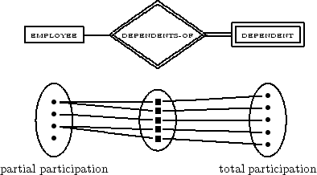
Example

Slide 28
Thank You
28

